Slide 1
Achieving Research Excellence:
Outlook for Federal Research Programs and Research Performance at MU and UMKC
Mun Y. Choi & C. Mauli Agrawal
1

Slide 2
MU R&D Performance

Slide 3
Why is Research Excellence Important?
“Productivity in research and other scholarly activities is the most distinguishing characteristic of the faculty of the University, setting it apart from all other public institutions in the state.”
- UM CRR 320.035
As a leading research university in the United States, our faculty make important discoveries and research breakthroughs in diverse fields ranging from agriculture to health to the humanities and arts.
Discovery-led innovations by MU researchers have improved the lives of our citizens and transformed society — whether they are new techniques to combat disease in plants and animals, solutions to human disease, innovations in infrastructure, or a greater understanding of our human history.
Moreover, our research and scholarly efforts serve as an important economic driver in Missouri that contribute to the $5.4B annual economic impact.
The lack of investments in the past has not achieved the excellence expected of a leading research institution.

Slide 4

AAU Membership
AAU is comprised of America’s 66 leading research universities.
AAU universities earn the majority of federal research funding that improves public health, seeks to address national challenges, and contributes significantly to our economic strength, while educating and training tomorrow’s visionary leaders.
AAU universities shape policy for higher education, science, and innovation; promote best practices in undergraduate and graduate education, and strengthen the contributions of leading research universities to American society.
Mizzou has been a member of AAU since 1908.
MU is the 16th member added to AAU after:
  Harvard, Yale, Princeton, Columbia, Cornell, Stanford, Chicago, UPenn, Johns Hopkins, UC Berkeley, Michigan, Virginia, Wisconsin, Catholic U and Clark U.
R&D performance is the most important factor for membership in AAU.

Slide 5
AAU Indicators of Research Excellence
Phase I
Federal expenditures: National Science Foundation (NSF) research expenditure data, excluding formula-allocated USDA research expenditures
Membership in the National Academies of Science, Engineering and Medicine
Faculty awards, fellowships and memberships: Number of prestigious faculty awards, fellowships and memberships (EX: Nobel Prize)
Citations of works: journal articles, books, conference proceedings, etc.
Phase II
USDA, state, and industrial expenditures : USDA research programs, such as AFRI, that can be separately identified in reported data are included in Phase I data
Doctoral education: Number of PhDs granted annually
Postdocs: Number of postdoctoral appointees
Undergraduate education: Is the institution meeting its commitment to undergraduate education?
5

Slide 6
Under-Reporting of MU R&D Expenditures

Slide 7
Under-Reporting of MU R&D Expenditures
 | New Phase I | Old Phase I | % Under-Reporting
FY16 | $110M | $95M | 13.6%
FY17 | $120M | $96M | 20.0%
FY18 | $123M | $99M | 19.5%
FY19 | $127M | $112M | 11.8%
FY20 | $140M | $123M | 12.1%
FY21 | $144M | $123M | 14.6%

Slide 8
Under-Reporting of MU R&D Expenditures
 | New Phase II | Old Phase II | % Under-Reporting
FY16 | $47M | $22M | 53.2%
FY17 | $40M | $20M | 50.0%
FY18 | $42M | $21M | 50.0%
FY19 | $47M | $24M | 48.9%
FY20 | $55M | $30M | 45.5%
FY21 | $61M | $27M | 55.7%

Slide 9
Accurate Reporting of MU R&D Expenditures

Slide 10
2016 to 2021 increase of 36.3%

Slide 11
MU Federal R&D Exp. per Faculty
2016 to 2021 increase of 39.5%

Slide 12
2016 to 2021 increase of 41.6%

Slide 13
2016 to 2021 increase of 40.0%

Slide 14
MU Federal R&D Performance
Year | 2009 | 2014 | 2016 | 2019 | 2020 | 2021
MU’s Federal R&D Expenditures Per Faculty | $104K | $87K | $115K | $126K | $152K | $160K
MU’s Rank for Federal R&D Expenditures Per Faculty | 59th out of 64 American AAUs | 63rd out of 64 American AAUs | 61st out of 64 American AAUs | 62nd out of 64 American AAUs | Preliminary Data: 58th out of 63 Amer. AAUs | N/A
 | 2009-14 |  | 2016-2019 | 2016-20 | 2016-21
% Increase in Federal R&D Expenditures Per Faculty during Period | -15.7% |  | 10.0% | 32.6% | 39.1%
MU’s Rank out of 64 AAU Institutions for % increase during Period | 63rd out of 64 American AAUs |  | 37th out of 64 American AAUs | Preliminary Data: 10th out of 63 Amer. AAUs | N/A

Slide 15
Leading R&D Indicators at MU Show Great Promise
2016-21 Change in Total R&D Proposals Per Faculty | 2016-21 Change in Total R&D Awards. Per Faculty | 2016-21 Change in Total R&D Exp. Per Faculty
73.0% | 64.5% | 36.3%
2016-21 Change in Federal R&D Proposals Per Faculty | 2016-21 Change in Federal R&D Awards Per Faculty | 2016-21 Change in Federal R&D Exp. Per Faculty
81.1% | 70.1% | 39.5%
2016-21 Change in Phase I R&D Proposals Per Faculty | 2016-21 Change in Phase I R&D Awards Per Faculty | 2016-21 Change in Phase I R&D Exp. Per Faculty
77.1% | 65.7% | 49.3%
2016-21 Change in Phase II R&D Proposals Per Faculty | 2016-21 Change in Phase II R&D Awards Per Faculty | 2016-21 Change in Phase II R&D Exp. Per Faculty
97.9% | 72.4% | 40.0%

Slide 16
Importance of Evaluating the R&D Performance at the College/Department Levels

Slide 17
MU Federal R&D Proposals
 | FY16 | FY19 | FY21
CAFNR | $65,437,857 | $127,039,040 | $153,089,823
Arts & Science | $96,540,776 | $100,898,254 | $143,783,675
Business | $407,765 | $0 | $0
Education | $62,927,580 | $108,144,194 | $170,678,525
Engineering | $90,150,889 | $122,886,400 | $130,377,297
Health Professions | $17,986,758 | $20,568,939 | $32,463,436
Journalism | $6,999 | $399,961 | $10,651,332
Law | $0 | $499,337 | $0
Medicine | $201,183,497 | $318,956,917 | $338,257,476
Nursing | $34,710,107 | $8,645,727 | $6,019,547
Veterinary Medicine | $101,914,528 | $129,593,994 | $126,676,891
Extension | $0 | $497,383 | $481,297

Slide 18
MU Federal R&D Awards
 | FY16 | FY19 | FY21
CAFNR | $26,527,158 | $30,185,304 | $34,430,457
Arts & Science | $22,318,161 | $26,160,132 | $21,253,292
Business | $0 | $0 | $0
Education | $21,794,754 | $22,258,047 | $26,821,025
Engineering | $12,421,156 | $26,581,922 | $25,641,736
Health Professions | $3,391,839 | $1,575,783 | $2,054,849
Journalism | $494,467 | $288,118 | $98,879
Law | $0 | $0 | $0
Medicine | $29,569,780 | $35,325,357 | $58,489,675
Nursing | $5,136,530 | $5,576,425 | $481,795
Veterinary Medicine | $7,630,293 | $13,388,271 | $12,564,539
Extension | $635,539 | $1,173,021 | $893,744

Slide 19
MU Federal R&D Expenditures
 | FY16 | FY19 | FY21
CAFNR | $23,082,008 | $24,921,531 | $27,154,149
Arts & Science | $25,342,712 | $27,738,367 | $19,176,843
Business | $0 | $21,420 | $0
Education | $9,108,990 | $12,629,420 | $16,010,162
Engineering | $13,077,169 | $17,055,548 | $22,432,297
Health Professions | $3,125,694 | $2,019,553 | $2,333,859
Journalism | $84,690 | $322,607 | $515,407
Law | $0 | $0 | $151,892
Medicine | $25,424,656 | $28,909,228 | $47,094,055
Nursing | $5,209,191 | $5,726,340 | $2,989,454
Veterinary Medicine | $8,196,433 | $10,467,752 | $12,606,536
Extension | $660,229 | $853,773 | $92,771

Slide 20
MU’s Focus in Growing Research Performance

Slide 21
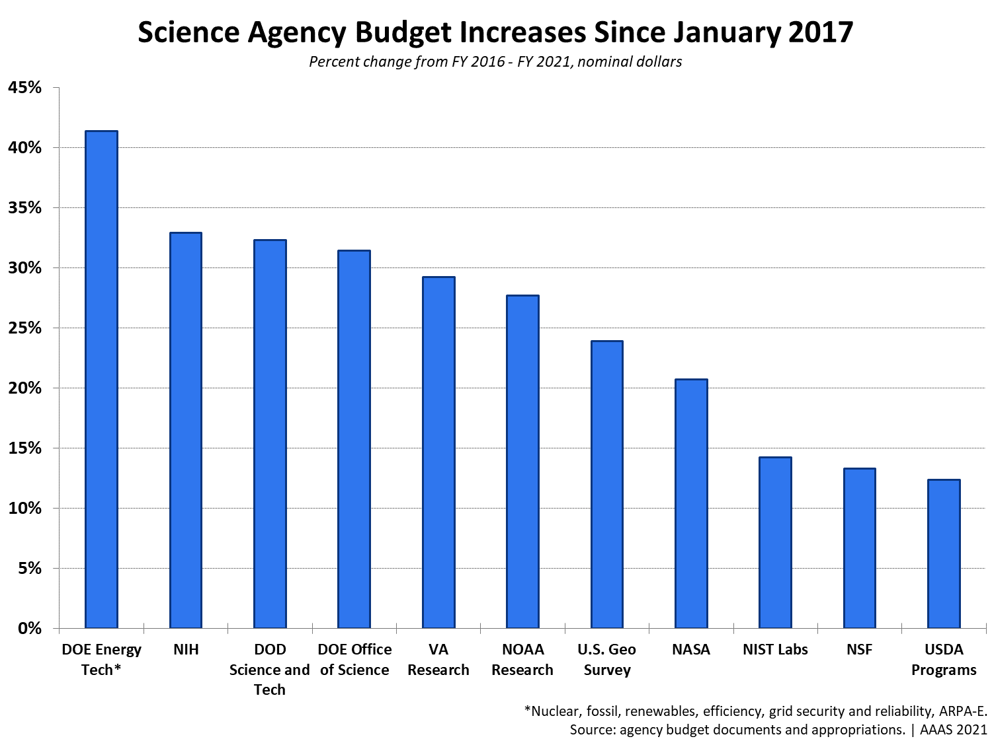

Slide 23
R&D Elements in the American Jobs Plan
~$250 billion over 8 years for R&D and related activities. Including:
  $50 billion for a new NSF technology directorate
  $30 billion for pandemic preparedness
  $30 billion for R&D “that spurs innovation and job creation, including in rural areas”
  $40 billion for research infrastructure – half to minority institutions
  $35 billion for energy / climate technology, including an “ARPA-Climate”
  $25 billion for R&D, Centers of Excellence at minority institutions
  NIST: $14 billion “to bring together industry, academia, and government to advance technologies and capabilities critical to future competitiveness”
  Semiconductors: $50 billion for research and manufacturing
  Plus ARPA-Infrastructure, innovation hubs, procurement-driven innovation, supply chain resilience, etc
Slide from Matt Hourihan of AAAS

Slide 24

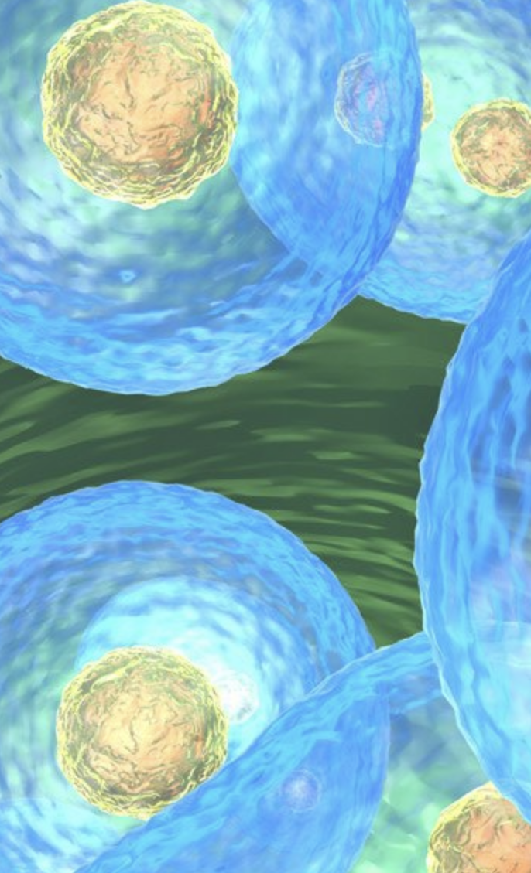
Key Scientific Focus Areas of NIH
Biomedical Engineering & Biophysics
Cell & Cancer Biology
Chemical Biology
Chromosome Biology
Computational Biology
Developmental Biology
Molecular Biology & Biochemistry
RNA Biology
Stem Cell Biology
Structural Biology
Systems Biology
Epidemiology
Genetics & Genomics
Health Disparities
Immunology
Microbiology & Infectious Diseases
Molecular Pharmacology
Neuroscience
Social & Behavioral Sciences
Virology

Slide 25
Securing American Leadership in Science and Technology Act (SALSTA)
Slide from Matt Hourihan of AAAS

Slide 26
Key Scientific Focus Areas of Federal R&D Agencies
NSF emphasis areas: Biocomplexity in the Environment; Information Technology Research; Nanoscale Science and Engineering; Mathematical Sciences; Human and Social Dynamics.
DOD emphasis areas: Hyper-sonics; Directed energy; Command, control and communications; Space offense and defense; Cybersecurity; Artificial intelligence/machine learning; Missile defense; Quantum science and computing; Microelectronics; Autonomy
DOE emphasis areas: Basic Energy Sciences; Biological & Environmental Research; Fusion Energy Sciences; High Energy Physics; Nuclear Physics
NASA emphasis areas: Astrophysics; Earth Sciences; Helio-physics; Planetary Science
Congressional Infrastructure Programs: Advanced Manufacturing; Advanced Construction Technologies; Climate Science; Resilience

Slide 27
UMKC Research
Strategic Overview
UM System Board of Curators
September 2, 2021

Slide 28
Total proposals FY2016-21

Slide 29
Proposals per faculty

Slide 30
Awards FY2016-2021 (all brand new awards)

Slide 31
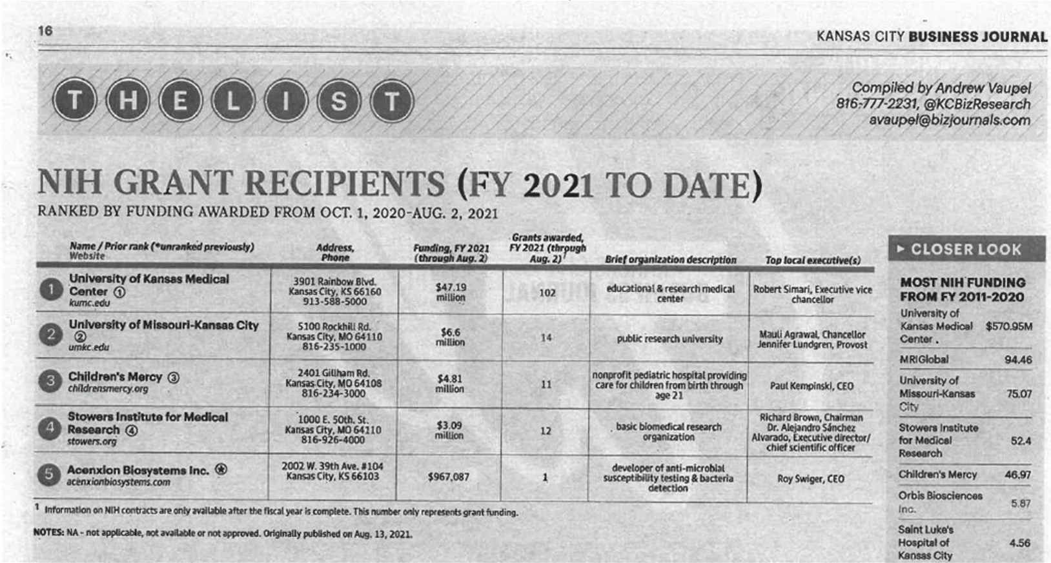
UMKC and other KC research peers

Slide 32
Awarded dollar amount FY2016-2021
(Dollars in Thousands)

Slide 33
R&D expenditures (2016-2020)
(Dollars in Thousands)

Slide 34
Total R&D expenditures per all faculty vs STEM/Health faculty

Slide 35
Federal R&D expenditures per faculty

Slide 36
Number of advanced degrees conferred

Slide 39
Faculty by tenure status

Slide 40
Number of tenured and tenure-track faculty

Slide 41
UMKC strategies to grow research
UMKC Strategic Plan (2018-2028)
  Develop investment pools and endowments to support faculty research, start-up funding, equipment purchases, mentoring
  Expand Office of Research Services to support faculty innovation and scholarship
  Make targeted investments in equipment, capital improvements and core facilities
  Promote “cluster hiring” in key areas of research strength

Slide 42
UMKC Forward: Research excellence
Infrastructure
  Invest in grant writers and pre-award/post-award staff
  Certified staff; “cluster hiring” within academic units
Faculty Support and Development
  Add faculty: $5M over the next 3 years
  Start-up funding
  Build faculty research skill and capacity
    CAFE programming; Matrix-Mentoring
    Free up time through course release/buy out program for grant development and submission

Slide 43
Center for Advancing Faculty Excellence (CAFE)
Teaching & Learning Pillar
 | Year-round programming (CAFE, D&I, OEL)
 | Campus-Specific Instructional Support and Resources
 | New Faculty Orientation & NTT/Adjunct Support
 | Course Evaluations & Peer Teaching Observations
 | Scholarship of Teaching and Learning
 | Faculty Learning Communities
 | Assessment & Analytics for Student Success - Outcomes Lab
 | Annual Theme-based Teaching Mini-Conference
Research & Creativity Pillar
 | Year-round programming (CAFE, ORS)
 | Grant-Writing Institutes & Research Mentor Program
 | Small Grants Program for Proposal Development
 | Grant and Fellowship Proposal Pre-Submission Peer Review
 | Collaboration Facilitator and Innovation Incubator
 | Faculty Writing Initiatives
 | Annual Theme-based Research Mini-Conference
Service & Engagement Pillar
 | Year-round programming (CAFE, Engagement)
 | Service and engagement in High-Impact Practices
 | Community-Engaged Learning
 | Community-Engaged Service, Research and Creative Work
 | Faculty Learning Communities
Career Progression, Leadership & Faculty Life Pillar
 | Year-round programming (CAFE, HR)
 | New Faculty Orientation (year-long program)
 | Mid-Career NextSteps Program
 | Department Chair Development and Support
 | Promotion & Tenure Workshops & Mentors
 | Faculty Awards & Recognition
 | Faculty Affairs Newsletter
 | Faculty Ombuds Services
CAFE Partners
CAFE Advisory Board
External Relations & Community Engagement
Office of Research Services Diversity & Inclusion
Affirmative Action
Human Resources
Missouri Online
UMS Academic Affairs

Slide 44
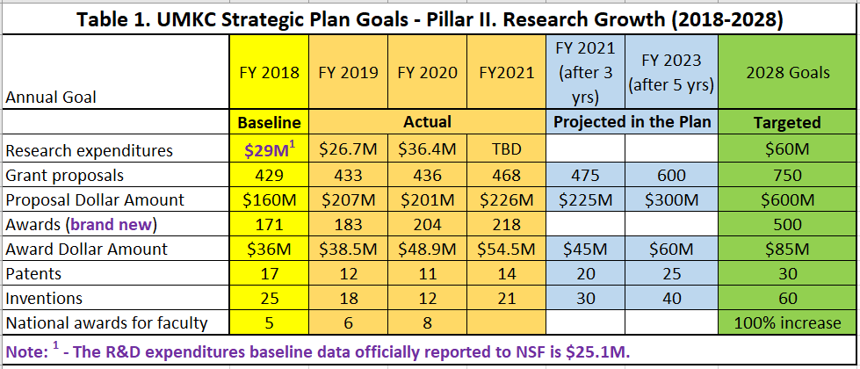
UMKC progress toward Strategic Plan goals in research

Slide 45
Areas of focus
All faculty research will be supported.
Special emphasis will be given to:
  Data Science
  Defense
  Biomedical (in collaboration with NextGen Precision Health)

Slide 46
Questions?

Slide 47
Extra Slides

Slide 48
Measuring R&D Performance
The most important metric for research performance is R&D expenditures.
R&D awards represent a leading indicator.
  Need to receive awards to expend the funds to support research.
R&D proposals represent a leading indicator.
  Need to write proposals to receive awards to expend the funds to support research.

Slide 49
2016 to 2021 increase of 64.5%

Slide 50
2016 to 2021 increase of 70.1%

Slide 51
2016 to 2021 increase of 65.7%

Slide 52
2016 to 2021 increase of 72.4%

Slide 53
2016 to 2021 increase of 73.0%

Slide 54
2016 to 2021 increase of 81.1%

Slide 55
2016 to 2021 increase of 76.4%

Slide 56
2016 to 2021 increase of 97.9%

Slide 57
MU Total R&D Proposals
 | FY16 | FY19 | FY21
CAFNR | $89,506,051 | $160,736,785 | $186,587,414
Arts & Science | $110,551,514 | $133,258,946 | $153,039,552
Business | $407,765 | $81,508 | $0
Education | $67,598,193 | $114,412,797 | $174,240,503
Engineering | $105,041,226 | $150,916,132 | $143,340,734
Health Professions | $20,878,290 | $24,439,263 | $37,919,970
Journalism | $6,999 | $559,921 | $10,676,121
Law | $0 | $706,983 | $0
Medicine | $242,545,137 | $370,926,882 | $401,315,919
Nursing | $36,363,186 | $10,928,565 | $7,202,927
Veterinary Medicine | $112,971,693 | $137,774,540 | $134,148,745
Extension | $649,827 | $2,094,429 | $747,085

Slide 58
MU Total R&D Awards
 | FY16 | FY19 | FY21
CAFNR | $35,730,144 | $41,322,288 | $50,707,751
Arts & Science | $23,193,296 | $29,552,230 | $22,780,023
Business | $0 | $0 | $0
Education | $21,973,267 | $23,986,005 | $27,410,132
Engineering | $13,936,682 | $28,201,735 | $28,156,561
Health Professions | $7,830,847 | $3,193,654 | $5,799,464
Journalism | $494,467 | $288,118 | $123,668
Law | $0 | $0 | $0
Medicine | $39,548,649 | $48,600,394 | $75,648,139
Nursing | $6,191,530 | $7,641,864 | $2,065,268
Veterinary Medicine | $10,461,596 | $14,713,016 | $14,808,271
Extension | $1,096,500 | $2,496,843 | $1,045,743

Slide 59
MU Total R&D Expenditures
 | FY16 | FY19 | FY21
CAFNR | $32,205,428 | $34,704,056 | $36,614,724
Arts & Science | $26,447,246 | $30,101,038 | $21,178,353
Business | $14,537 | $23,179 | $40,079
Education | $10,454,831 | $14,087,655 | $16,855,215
Engineering | $14,691,725 | $18,087,743 | $23,851,155
Health Professions | $3,397,074 | $3,573,457 | $4,853,956
Journalism | $84,690 | $441,438 | $545,090
Law | $2,034 | $13,901 | $153,575
Medicine | $31,432,852 | $38,736,003 | $61,936,430
Nursing | $6,347,658 | $6,729,236 | $4,061,617
Veterinary Medicine | $10,126,392 | $11,985,674 | $14,008,701
Extension | $934,599 | $1,230,082 | $115,657

Slide 60
Leading R&D Indicators at MU Show Great Promise
2016-21 Change in Total R&D Exp. Per Faculty | 2016-21 Change in Federal R&D Exp. Per Faculty | 2016-21 Change in Phase I R&D Exp. Per Faculty | 2016-21 Change in Phase II R&D Exp. Per Faculty
36.3% | 39.5% | 49.3% | 30.0%
2016-21 Change in Total R&D Awards. Per Faculty | 2016-21 Change in Federal R&D Awards Per Faculty | 2016-21 Change in Phase I R&D Awards Per Faculty | 2016-21 Change in Phase II R&D Awards Per Faculty
64.5% | 70.1% | 65.7% | 72.4%
2016-21 Change in Total R&D Proposals Per Faculty | 2016-21 Change in Federal R&D Proposals Per Faculty | 2016-21 Change in Phase I R&D Proposals Per Faculty | 2016-21 Change in Phase II R&D Proposals Per Faculty
73.0% | 81.1% | 77.1% | 97.9%

Slide 61
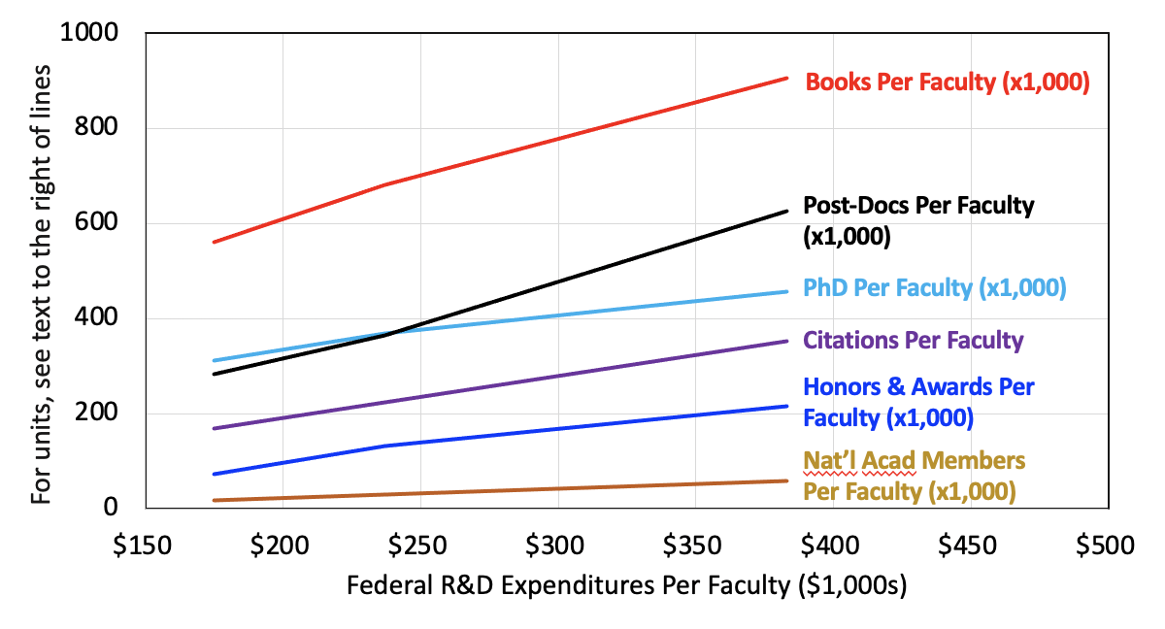
Objective Indicators of Research Excellence
If we are to become a stronger research institution, we must compare ourselves using indicators that the top research institutions employ, namely AAU and Carnegie Research I indicators.
61

Slide 62
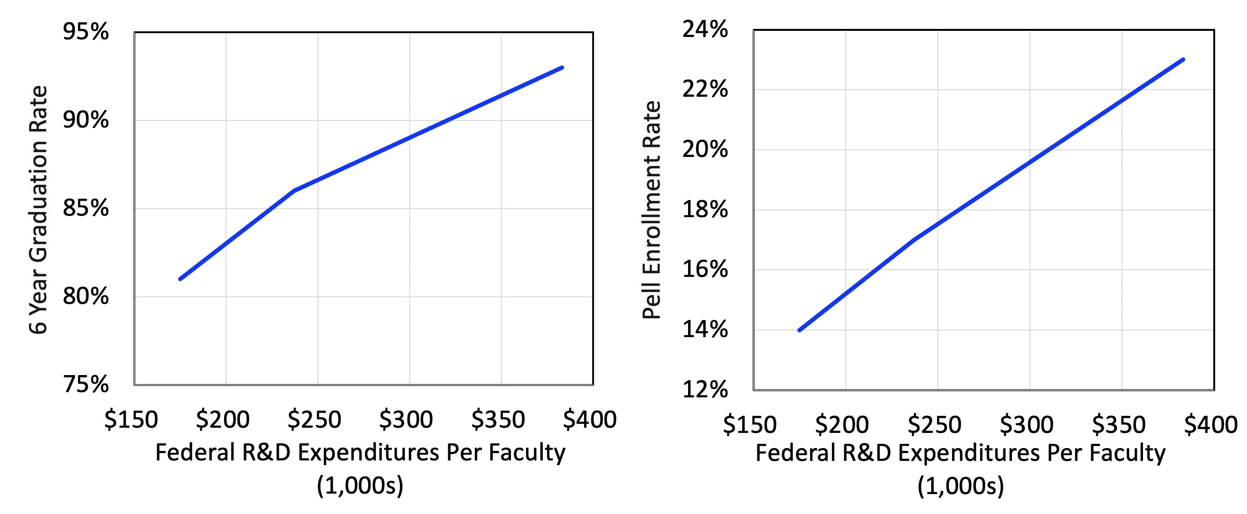
Objective Indicators of Research Excellence
There’s a high degree of correlation between R&D expenditures and student success indicators.

Slide 63
National Institutes of Health
NIH topline: $52 billion ($+9 billion, +21%)
Most institutes rise ~3%. Some outliers:
  Minority Health +66%
  Drug Abuse +25%
  NIEHS: +14%
  Neuro Disorders: +11%
Slide from Matt Hourihan of AAAS

Slide 64
National Science Foundation
NSF topline: $10 billion ($+1.7 billion, +20%)
Largest increases for GEO and ENG, smallest for MPS
  Relatively larger increases for Advanced Industries (AI, quantum, biotech, etc)
Research grants up 1,800, success rate: 28%
  Also ~$22,000 increase in median annualized award size
EHR: +16% or +$177 million, mostly for STEM diversity
Research Infrastructure up 5%; larger focus on midscale infrastructure and instrumentation
Slide from Matt Hourihan of AAAS

Slide 65
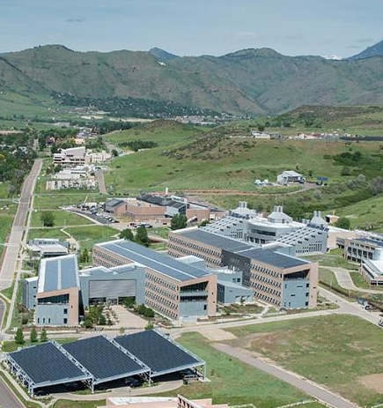
Other Agencies of Note
DOE: +6% for Office of Science (largest for Bio and Enviro Research), huge increase for EERE
NASA +9%
Dept of Agriculture Advanced Food Research Initiative (AFRI) : $700 million
The budget broadly prioritizes applied science and technology, even when it’s labeled “basic research”
  Connected Science: ARPAs (climate, infrastructure, energy, health)
  Manufacturing programs (NIST, DOE, NSF)
  Climate research (NOAA, USGS, NASA)
Slide from Matt Hourihan of AAAS

Slide 66

Research, Technology & Manufacturing R&D Opportunities
Securing American Leadership in Science and Technology Act (SALSTA)
American Cures Act
American Innovation Act
Innovation Centers Acceleration Act
Quantum Legislation
National Manufacturing Guard Act
National Artificial Intelligence Commission

